Slide 1

Elementary MATLAB® Course – Session 1
Instructor: Sina Ghanbari
Kimia Scientific Group - Chemical & Petroleum Department
Sharif University of Technology
April 2024

Slide 2

Contents
What is MATLAB?
Getting Started with MATLAB Environment
Data Types
Basic Commands
Converting Datatypes Together
Working With Vectors and Matrices

Slide 3


What is MATLAB® ?
MATLAB is a matrix-based tool for numerical computations. It's very powerful and easy to use.
Both programming language and interactive environment!
Notes:
تمام داده‌ها در متلب به شکل یک ماتریس ذخیره می‌شوند. برای مثال یک عدد (اسکالر) به شکل یک ماتریس ۱*۱ ذخیره می‌شود. یک رشته مانند «Whale is the biggest animal» به شکل ماتریسی با یک سطر و چندین ستون (که تعداد ستون‌ها به تعداد کاراکترهاست) ذخیره می‌شود. حتی یک تصویر به شکل یک ماتریس سه بعدی ذخیره می‌گردد که بُعد اول و دوم آن برای تعیین مختصات نقاط و بُعد سوم آن برای تعیین رنگ نقاط استفاده می‌شود. فایل‌های صوتی نیز در متلب به شکل ماتریس‌های تک ستون (بردارهای ستونی) ذخیره می‌شوند؛ بنابراین جای تعجب نیست که متلب مخفف عبارت آزمایشگاه ماتریس باشد.

Slide 4
Advantages and Disadvantages of MATLAB®
Advantages
User-Friendly
Rich Functionality
Disadvantages
Cost (Excludes Toolboxes)
Not Ideal for Large-Scale Projects
Powerful Visualization
Community and Resources
Resource Intensive
Lack of Speed
Notes:
Advantages:
Versatile: MATLAB is a versatile tool, widely used across various scientific and engineering disciplines.
User-Friendly: MATLAB's user-friendly interface makes it accessible to users with varying levels of programming expertise.
Rich Functionality: It offers a vast array of built-in functions, toolboxes, and packages for various applications.
Powerful Visualization: MATLAB excels in data visualization, offering extensive plotting and graphing capabilities.
Community and Resources: A large user community means plenty of resources, forums, and support are available.
Interoperability: MATLAB can seamlessly integrate with other languages like C++, Python, and Java.
Disadvantages:
Cost: MATLAB can be expensive for individuals and smaller organizations, with licensing fees.
Resource Intensive: MATLAB can be resource-intensive, requiring substantial memory and processing power for complex simulations.
Lack of Speed: In certain applications, MATLAB may not be as fast as lower-level languages like C++ or Fortran.
Not Ideal for Large-Scale Projects: It may not be the best choice for large-scale software development due to limitations in scalability.
Limited Multithreading: MATLAB's support for multithreading and parallel processing has limitations.
These points provide a balanced view of MATLAB's strengths and weaknesses, helping your audience make informed decisions regarding its use.

Slide 5
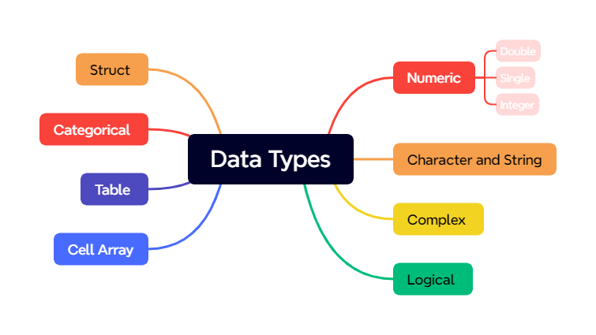

Slide 6
Numeric
Numeric types from memory POV
double | Double-precision arrays
single | Single-precision arrays
int8 | 8-bit signed integer arrays
int16 | 16-bit signed integer arrays
int32 | 32-bit signed integer arrays
int64 | 64-bit signed integer arrays
uint8 | 8-bit unsigned integer arrays
uint16 | 16-bit unsigned integer arrays
uint32 | 32-bit unsigned integer arrays
uint64 | 64-bit unsigned integer arrays
Integer
Float
Complex
Notes:
uint8 represents unsigned integers using 8 bits, allowing values from 0 to 255.
uint16 represents unsigned integers using 16 bits, allowing values from 0 to 65535.
uint32 represents unsigned integers using 32 bits, allowing values from 0 to 4294967295.
uint64 represents unsigned integers using 64 bits, allowing values from 0 to 18446744073709551615.
Single 32 bit , double 64 bit

Slide 7
Basic Commands for Workspace
who, whos current workspace vars.
clear all clear workspace vars.
close all close all figures
clc clear screen
clf clear figure
class(x) show the data type of ‘x’
input(x) Input ‘x’ from user
% used to denote a comment
%% used to divide your code into several sections
; suppresses display of value (when placed at end of a statement)
... continues the statement on next line

Slide 8
Basic Operation Commands
eps machine epsilon
inf machine infinity
realmin Smallest positive floating-point number
realmax Largest positive floating-point number
naN not-a number, e.g., 0/0.
Mathematical functions: sqrt(x), exp(x), cos(x), sin(x), log(x), log10(x), log2(x), asin(x),acos(x), sec(x), sinh(x), cosh(x), etc.
Mathematical Operations: + - * / ^ ’
Constants: pi, exp(1),

Slide 9
Note for Naming m-files
M-file names must start with an alphabetic character, may contain any alphanumeric characters or underscores, and must be no longer than the maximum allowed M-file name length(63 character).
Never use blank space in the file name.
Use ( _ ) instead of space or ( - )

Slide 10
Converting Data Types Together
Function
Number and Text
Hexadecimal and Binary
Dates and Time
Categorial Array, Tables, and Timetable
Cell Arrays and Structure
Notes:
Data Type Conversion - MATLAB & Simulink - MathWorks Benelux

Slide 11
Vectors & Matrices

Slide 12
Vectors & Matrices
v = [-4 8 0 2.5 -1.5]; % length 5 row vector.
v = v’; % transposes v.
v(1); % first element of v.
v= 4:-1:2; % same as v=[4 3 2];
a=1:3; b=2:3; c=[a b]; → c = [1 2 3 2 3];

Slide 13
x = linspace(-pi,pi,10); % creates 10 linearly-spaced elements from –pi to pi.
logspace is similar.
A = [1 2 3; 4 5 6]; % creates 2x3 matrix
A(1,2) % the element in row 1, column 2.
A(:,2) % the second column.
A(2,:) % the second row.

Slide 14
A+B, A-B, 2*A, % matrix addition, matrix subtraction, scalar multiplication
A.*B % element-by-element multiple
A./B % element-by-element div.
A’ % transpose of A (complex-conjugate transpose)
dot(A,B) % dot product of A & B
A*B % cross product of A & B
det(A) % determinant of A
inv(A) % inverse matrix of A

Slide 15
diag(v) % change a vector v to a diagonal matrix.
diag(A) % get diagonal of A.
eye(n) % identity matrix of size n.
zeros(m,n) % m-by-n zero matrix.
ones(m,n) % m*n matrix with all ones.
Randi([a, b], m,n) % Create a m*n matrix with random variables from a to b

Slide 16
More Matrices/Vector Operation
length(v) % determine length of vector.
size(A) % determine size of matrix.
find(A) % determine indices of non-zero elements
sum(A) % determine sum of elements
max(A) % determine maximum element
min(A) % determine minimum element
mean(A) % determine mean of elements
sort(A) % sort element from minimum to maximum value

Slide 17
End of Session 1
Thanks for your attention. 🙂

